Slide 1
Create a Chatbot with Azure Bot Server and QnA Maker
En Wu, Technical Instructor, eCloudvalley

Slide 2
Agenda
What are Chatbots?
Azure Bot Service
Demo: Creating a Chatbot

Slide 3
What are Chatbot?

Slide 4


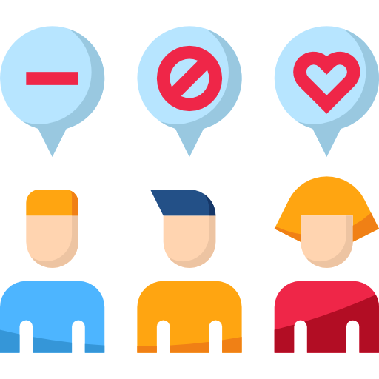



Evolution Of Communication
Notes:
A 3-tier architecture is a type of software architecture which is composed of three “tiers” or “layers” of logical computing. They are often used in applications as a specific type of client-server system. 3-tier architectures provide many benefits for production and development environments by modularizing the user interface, business logic, and data storage layers. Doing so gives greater flexibility to development teams by allowing them to update a specific part of an application independently of the other parts. This added flexibility can improve overall time-to-market and decrease development cycle times by giving development teams the ability to replace or upgrade independent tiers without affecting the other parts of the system.
For example, the user interface of a web application could be redeveloped or modernized without affecting the underlying functional business and data access logic underneath. This architectural system is often ideal for embedding and integrating 3rd party software into an existing application. This integration flexibility also makes it ideal for embedding analytics software into pre-existing applications and is often used by embedded analytics vendors for this reason. 3-tier architectures are often used in cloud or on-premises based applications as well as in software-as-a-service (SaaS) applications.

Slide 5
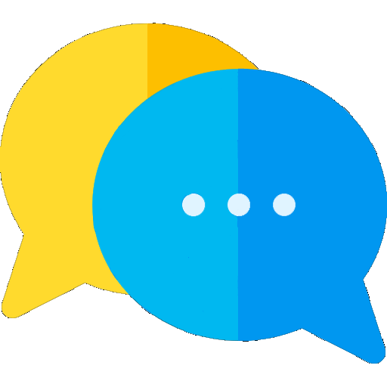
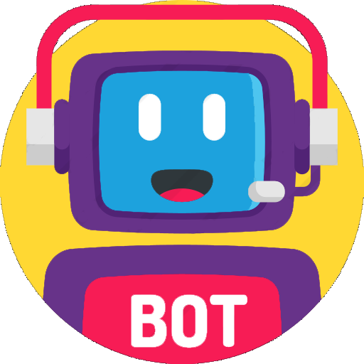
What are Chatbot ?
The class of bots that live online in chat
platforms or no social media
The most intuitive definition is that a bot is
soft ware that can have a conversation with
a human
Types:
Standard Chatbot
Self Learning Chatbot
Notes:
A 3-tier architecture is a type of software architecture which is composed of three “tiers” or “layers” of logical computing. They are often used in applications as a specific type of client-server system. 3-tier architectures provide many benefits for production and development environments by modularizing the user interface, business logic, and data storage layers. Doing so gives greater flexibility to development teams by allowing them to update a specific part of an application independently of the other parts. This added flexibility can improve overall time-to-market and decrease development cycle times by giving development teams the ability to replace or upgrade independent tiers without affecting the other parts of the system.
For example, the user interface of a web application could be redeveloped or modernized without affecting the underlying functional business and data access logic underneath. This architectural system is often ideal for embedding and integrating 3rd party software into an existing application. This integration flexibility also makes it ideal for embedding analytics software into pre-existing applications and is often used by embedded analytics vendors for this reason. 3-tier architectures are often used in cloud or on-premises based applications as well as in software-as-a-service (SaaS) applications.

Slide 6

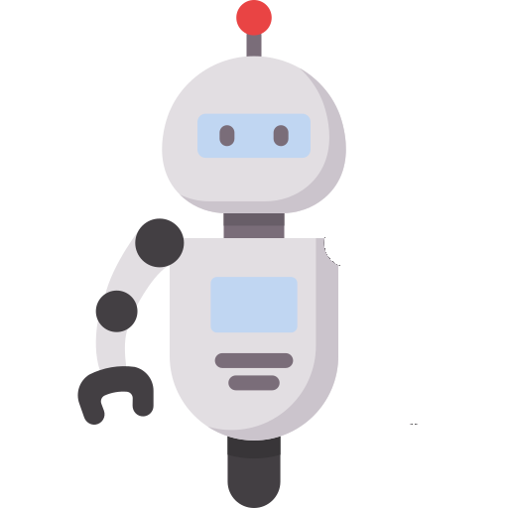

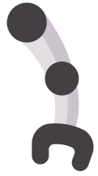




Why Do We Need Chatbot?
Performs Better than a human
Notes:
A 3-tier architecture is a type of software architecture which is composed of three “tiers” or “layers” of logical computing. They are often used in applications as a specific type of client-server system. 3-tier architectures provide many benefits for production and development environments by modularizing the user interface, business logic, and data storage layers. Doing so gives greater flexibility to development teams by allowing them to update a specific part of an application independently of the other parts. This added flexibility can improve overall time-to-market and decrease development cycle times by giving development teams the ability to replace or upgrade independent tiers without affecting the other parts of the system.
For example, the user interface of a web application could be redeveloped or modernized without affecting the underlying functional business and data access logic underneath. This architectural system is often ideal for embedding and integrating 3rd party software into an existing application. This integration flexibility also makes it ideal for embedding analytics software into pre-existing applications and is often used by embedded analytics vendors for this reason. 3-tier architectures are often used in cloud or on-premises based applications as well as in software-as-a-service (SaaS) applications.

Slide 7

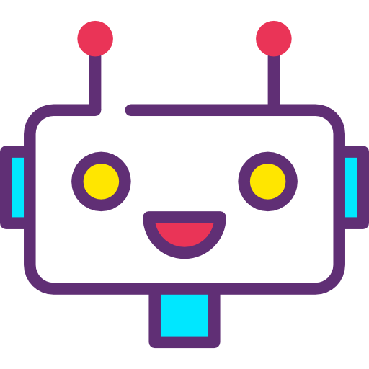


Why Do We Need Chatbot?
Easy To Replicate
Notes:
A 3-tier architecture is a type of software architecture which is composed of three “tiers” or “layers” of logical computing. They are often used in applications as a specific type of client-server system. 3-tier architectures provide many benefits for production and development environments by modularizing the user interface, business logic, and data storage layers. Doing so gives greater flexibility to development teams by allowing them to update a specific part of an application independently of the other parts. This added flexibility can improve overall time-to-market and decrease development cycle times by giving development teams the ability to replace or upgrade independent tiers without affecting the other parts of the system.
For example, the user interface of a web application could be redeveloped or modernized without affecting the underlying functional business and data access logic underneath. This architectural system is often ideal for embedding and integrating 3rd party software into an existing application. This integration flexibility also makes it ideal for embedding analytics software into pre-existing applications and is often used by embedded analytics vendors for this reason. 3-tier architectures are often used in cloud or on-premises based applications as well as in software-as-a-service (SaaS) applications.

Slide 8
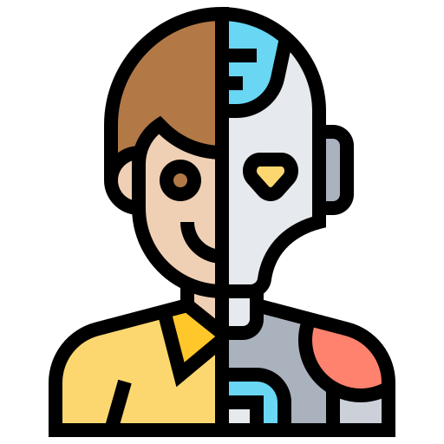
Why Do We Need Chatbot?
Artificial Intelligence
Notes:
A 3-tier architecture is a type of software architecture which is composed of three “tiers” or “layers” of logical computing. They are often used in applications as a specific type of client-server system. 3-tier architectures provide many benefits for production and development environments by modularizing the user interface, business logic, and data storage layers. Doing so gives greater flexibility to development teams by allowing them to update a specific part of an application independently of the other parts. This added flexibility can improve overall time-to-market and decrease development cycle times by giving development teams the ability to replace or upgrade independent tiers without affecting the other parts of the system.
For example, the user interface of a web application could be redeveloped or modernized without affecting the underlying functional business and data access logic underneath. This architectural system is often ideal for embedding and integrating 3rd party software into an existing application. This integration flexibility also makes it ideal for embedding analytics software into pre-existing applications and is often used by embedded analytics vendors for this reason. 3-tier architectures are often used in cloud or on-premises based applications as well as in software-as-a-service (SaaS) applications.

Slide 9
Something you need to know

Slide 10
Azure Bot Service
Provides an integrated environment that is purpose-built for bot development,
Enabling you to build, connect, test, deploy, and manage intelligent bots, all from one place.
Use modular and extensible framework provided by the SDK, tools, templates, and AI services developers
Create bots that use speech, understand natural language, handle questions and answers, and more.
Notes:
Azure Bot 服務和 Bot Framework 提供可在單一位置建立、測試、部署及管理智慧型 Bot 的工具。 利用 SDK 提供的模組化可延伸架構，工具、範本和 AI 服務開發人員可以建立可使用語音、理解自然語言、處理問與答等功能的 Bot。

Slide 11

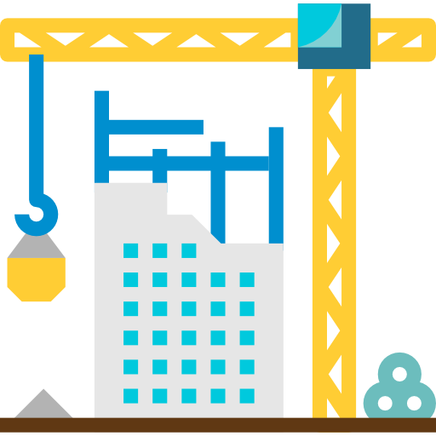



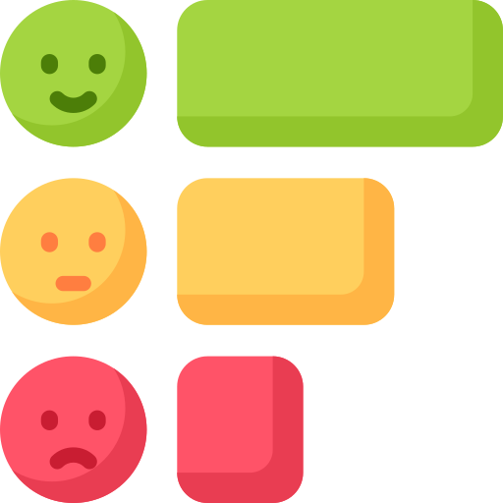
Azure Bot Service
Plan
Build
Test
Publish
Connect
Evaluate

Slide 12
QnA Maker
a cloud-based Natural Language Processing (NLP) service
Easily creates a natural conversational layer over your data.
It can be used to find the most appropriate answer for any given natural language input, from custom knowledge base (KB) of information.

Slide 13
When to use QnA Maker
When you have:
static information
provide the same answer to a request, question, or command
filter static information based on meta-information
manage a bot conversation that includes static information
Notes:
當您有靜態資訊時 - 當回答知識庫中有靜態資訊時，請使用 QnA Maker。 此知識庫是依據需求所自訂的，且您已使用 PDF 和 URL 等文件建置好。
當您想要為要求、問題或命令提供相同的答案時 - 當不同使用者提交相同問題時，系統會傳回相同的答案給他們。
當您想要根據中繼資訊來篩選靜態資訊時 - 新增中繼資料標籤，以提供與用戶端應用程式使用者和資訊相關的其他篩選選項。 常見的中繼資料資訊包括閒聊、內容類型或格式、內容用途和內容有效期限。
當您想要管理包含靜態資訊的聊天機器人對話時 - 您的知識會取得使用者的對話文字或命令，並做出回答。 如果答案是預先決定對話流程的一部分 (在您的知識庫中會以多回合內容來表示)，則聊天機器人可以輕鬆地提供此流程。

Slide 14
What We will Create

Slide 15
Thank you very much.

